Slide 2
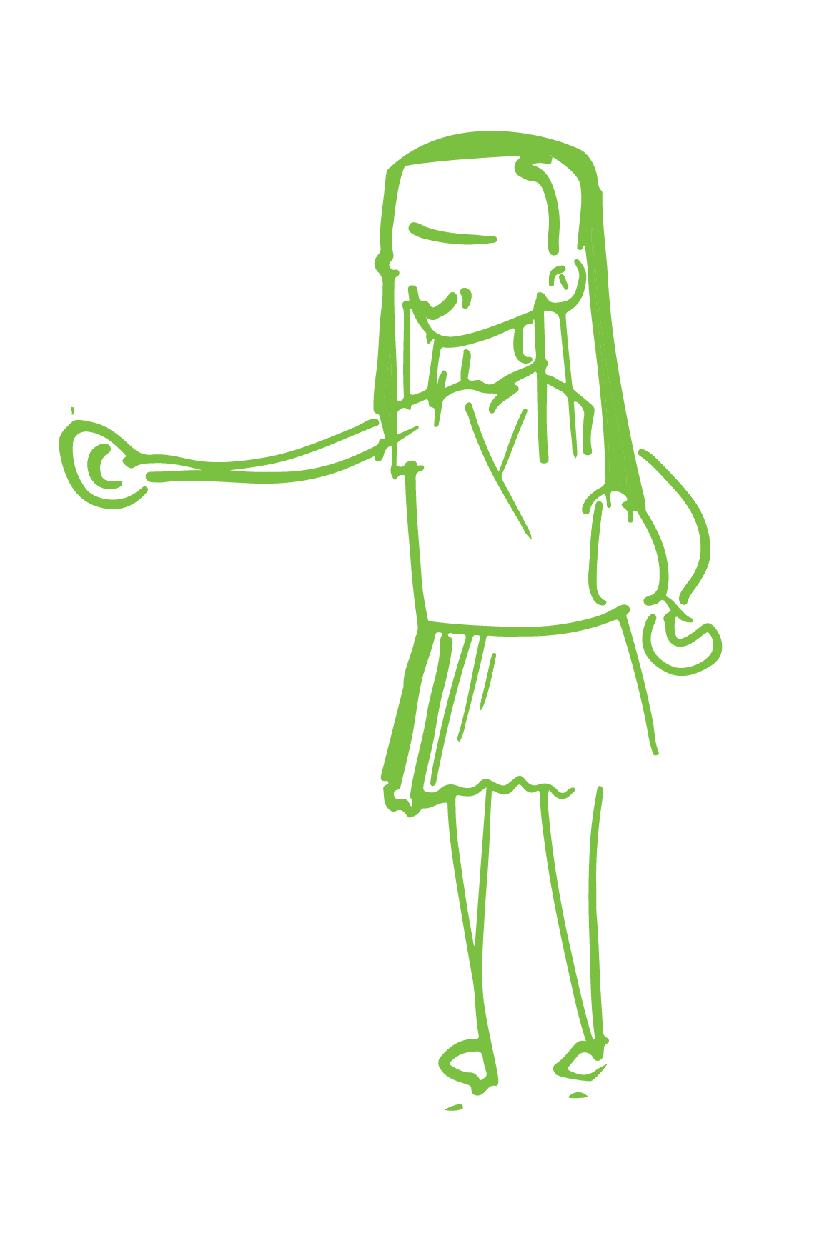
POSITIVE THINKING
Sam
I’m really looking forward to my ballet exam
I am never going to understand maths
I’ll have no one to sit next to if I join that new club
I wonder what the judo club will be like
Speaking in front of the whole class will be scary, but what an opportunity
I don’t want to be in the play, everyone will laugh at me
Notes:
Click to change negative thoughts into positive thoughts

