Slide 1
Notes:
DEAL is a free web based resource for professionals who work with young people

Slide 2
WHERE DO WE STAND?
Activity 2A
AGREE
DISAGREE
Continuum
Notes:
Ask all staff to imagine a line across the classroom. At one end is ‘strongly disagree’, and the other end is ‘strongly agree’. You can label the walls if it helps.
Read out each statement and ask staff to stand in the place that reflects how they feel. After each statement you can ask staff to volunteer to share why they are standing where they are, and then invite others to agree or share a different view. Staff should be encouraged to think about the benefits of learning about emotional health in the curriculum and to explore their personal views about this. ( But bear in mind that everyone will have different experiences and opinions)

Slide 3
WHAT IS EMOTIONAL HEALTH?
Emotional health is about how we think and feel. It is about our sense of wellbeing, our ability to cope with life events and our ability to acknowledge our own emotions, as well as those of others.
Emotional health means that we can find ways of keeping our life in balance. Its not about feeling happy or good all the time.
Notes:
Activity 2A
This is our definition of emotional health .
Discuss3

Slide 4
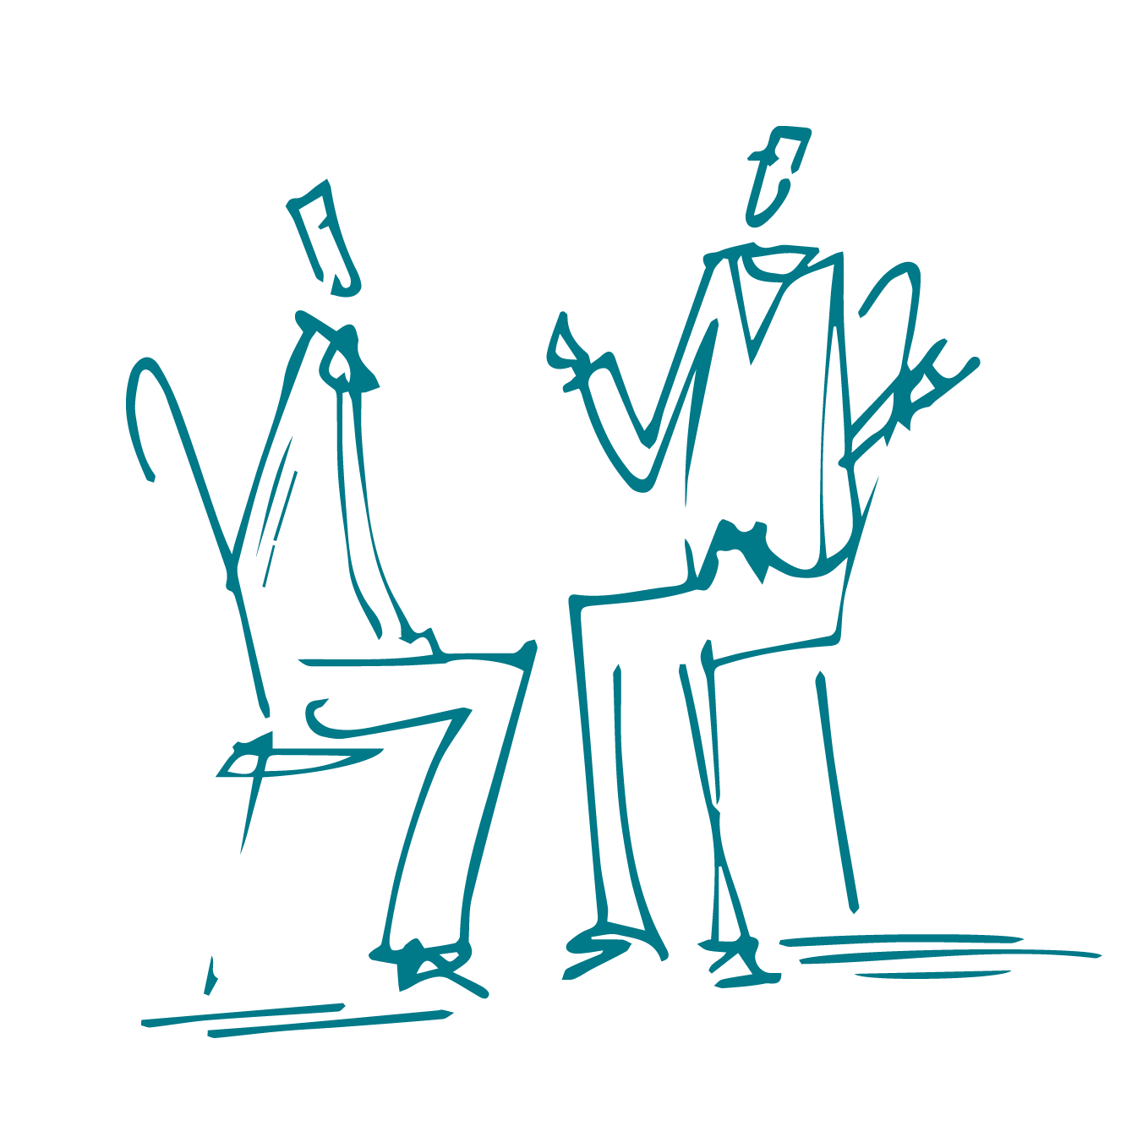
WHAT AFFECTS STUDENTS’ LEARNING?
Notes:
Ask staff to work in pairs and think of ten things that negatively affect students’ ability to learn at school. Allow a few minutes for this.

Slide 5
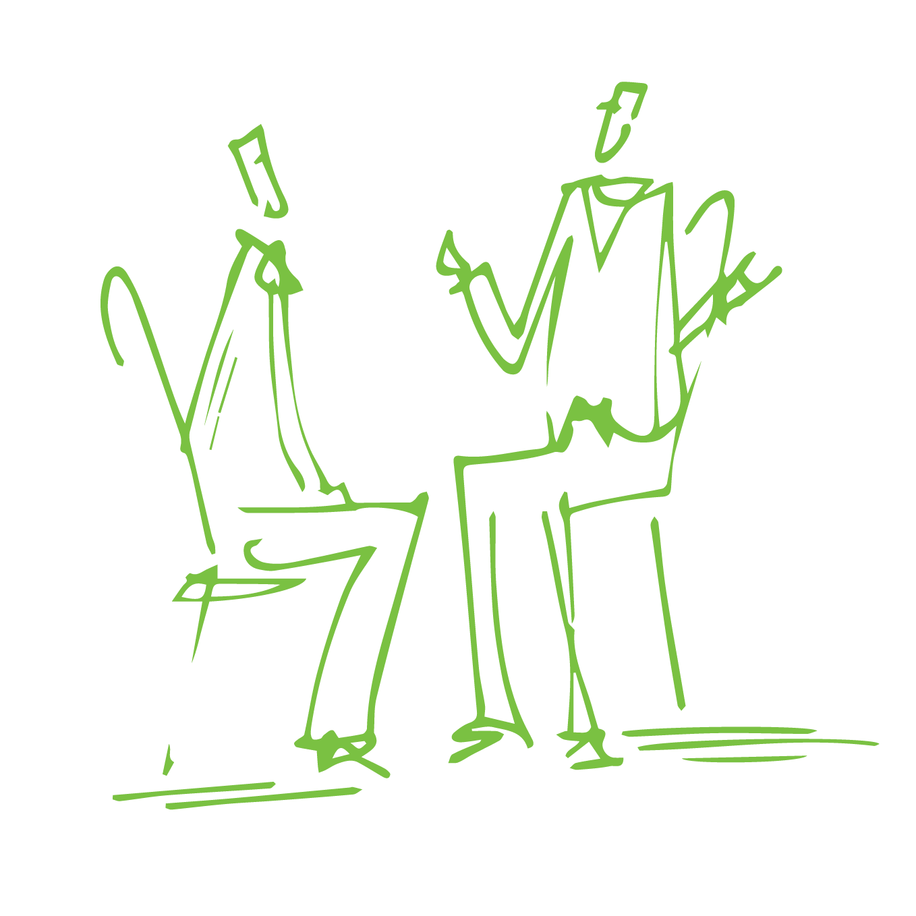
WHAT ASSISTS STUDENTS’ LEARNING?
Notes:
Ask staff to repeat this exercise in pairs for ten things that help students concentrate , learn and achieve at school.
Now ask each pair to go through both of their lists and underline all the answers that they think relate to emotional health or wellbeing. Feed these back and record them on flipchart paper so everyone can see.

Slide 6
WHAT DOES HEALTHY LOOK LIKE?
Notes:
In groups of three or four, ask participants to draw an outline of a person who is “healthy” on a large piece of paper. Ask them to draw in and around the body words and drawings to describe what that person does, looks like, likes to do, thinks, feels and how they behave. Allow at least ten minutes for this.
Then ask each group to highlight those characteristics that they think are to do with emotional health. They could colour code: one colour for physical health and one for emotional health.
Feedback and discuss. What did they discover or think about?
Ask the groups to consider whether they, as adults, would describe these things in the same way that teenagers would. Can they select the three most important things that contribute towards positive emotional health? Go from group to group, asking them to feed back their thoughts and ideas. Ask the group to consider (but not share) something that they are aware that they do contributes positively towards their emotional health. Ask them to think of something that they could do more of that would enhance their emotional health further.

Slide 7
CONCERNS OR FEARS?
If you are a student about to learn about emotional health or any of the themes covered in DEAL:
What concerns or fears might you have?
As a facilitator of the lesson what concerns or fears might you have?
Notes:
Activity 3 A
Ask the participants to think about the themes that are covered in DEAL using the theme overviews as a starting point. These are about emotional health, coping strategies, dealing with difficult feelings, asking for help and developing listening skills. Use the handout if needed. Many of the activities ask students to share their thoughts and ideas and cover some issues that may affect anyone in the classroom.
Tell the participants to imagine that they are a student sitting in a PSHE (or equivalent) lesson and the subject of difficult feelings is being introduced. Ask them to write down on the post it notes any concerns or fears they would have about being a part of these lessons (these same concerns and fears would probably also apply to the teacher) eg I’m scared that I’ll be asked about my personal life, what if I get upset? Explain that no one will be asked to read out their own ideas but that you
will be collecting them in and sharing the ideas recorded. Collect in the post it notes or slips of paper and put to one side.

Slide 8
SETTING GROUND RULES
What ‘rules’ do you need to have in place to feel safe and able to learn?
Notes:
In groups of three or four, ask participants to list three ‘rules’ that they would like to set so that the session feels safe and comfortable to take part in. Allow a few minutes, then collect ideas from groups and record on a board. Merge similar responses. When everyone’s contribution has been recorded, ask if there is anything else anyone would like to add, or that they are concerned about.
Agree that these are the ground rules that you will follow for these training sessions.
Look at each note from the previous activity in turn, read it aloud and ask if the concern would be overcome by having these new ground rules in place? If yes, put to one side, if no then put back in a pile. You will come back to these.
Most concerns about taking part in these sessions would be addressed by having ground rules for everyone to agree on. It has been shown that people engage more readily when they have ownership of the rules that have been set.
So if we set ground rules we can create a positive learning environment in which to discuss difficult issues.

Slide 9
DEAL ONLINE
Website
www.samaritans.org/deal
Notes:
A reminder of where you find the DEAL resources

